Slide 1

Data Driven Education
Discussion Forum Subteam
Presentation 2 - 10/21/2020

Slide 2






Team Members
Andrew Bauer
Data Scientist
Lindsey Blackmore
Project Manager
Web Developer
John Hosmer
Data Scientist
Sambhav Jaideep
Web Developer
Manny Jonson
Data Scientist
Morgan Powers
Project Manager
Web Developer
Notes:
All

Slide 3
Focus for Discussion Forum Subteam
Discussion forums are largely used in college courses especially with the swift transition to primarily online course formats
Student interaction in these forums provides indications of their participation as well as cognitive presence
Metrics and analysis on this information can be leveraged by professors to better grasp their students’ understanding, thoughts on the course/material, and more
Creating a web application to be used by professors will allow the instructors to improve their courses

Slide 4
Data Science Team
Data science team is looking to deliver a workable cognitive presence model by the end of the month or pivot to a workstream where we can find more success
We have provided support for the front end where needed
All modelling work has been uploaded into github so future team members can view what has been done and might be able to make improvements to work we have yet to complete

Slide 5
Cognitive Presence Modelling - Intro
Cognitive presence modelling attempts to track how a conversation flows from a triggering event to a resolution within a community of inquiry
The cognitive presence model that we base this work off of^{[7][8]} includes 5 phases: No cognitive presence, triggering event, exploration, integration, and resolution
  These labels are consistent across human labelers^{[6]}
The prior semester provided labeled data which made this work possible
One of the major challenges we are up against is that question asked in the context of a class are dissimilar to other conversation

Slide 6
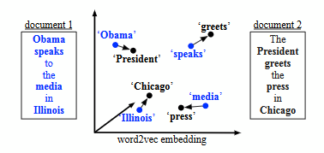
Cognitive Presence Modelling - Word Mover’s Distance
One method that we have used for trying to classify new cases is the word mover’s distance metric^{[5]} paired with a KNN classifier
The word mover’s distance metric compares two documents by measuring the distance between word embeddings from every word in the two documents
For our KNN, we find the closest N
documents and pick the most
frequently appearing one as the
label
The classic WMD example from [5]

Slide 7
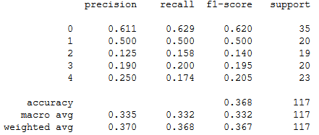

Cognitive Presence Modelling - Word Mover’s Distance
Our initial results are somewhat positive, especially for classifying no cognitive presence and triggering events
The other 3 categories (exploration, integration, and resolution) frequently classify as other items in their group
The best results we are seeing are currently at a K of 7
To break ties we weight each item by a scalar subtracted by its word mover’s distance metric
Test set confusion matrix
Test set metrics

Slide 8
Cognitive Presence Modelling - Word Mover’s Distance
To improve the results of the model we are have a couple of ideas
See how well we classify if we bunch exploration, integration, and resolution as one category
Improve the voter metric by studying the distribution of distances and more intelligently weighting extremely similar instances
Clean up the data further
  Replace links
  Try to find and replace code blocks

Slide 9
Cognitive Presence Modelling - Transformers
What are transformers?
  Provide thousands of pretrained models to perform text classification, information extraction, question and answering, and many more tasks
What is huggingface?
  A python API that provides state of the art NLP models back by the PyTorch and TensorFlow deep learning libraries
  Allows one to quickly download and use pretrained models to fine tune them on specific datasets

Slide 10
Cognitive Presence Modelling - BERT
BERT
  An industry leading NLP model often used for text classification
First pass at BERT
  Although a lot of the work was done for us, the fine tuning and validation step was very time consuming
  Our preliminary results show that BERT is bias towards the mean
    1st guess - most popular, 2nd guess - second most popular, etc.
  We believe the results may be skewed due to lack of data

Slide 11
Cognitive Presence Modelling - Other Transformers
Moving forward
  We plan to explore other transformer models and compare and contrast the results
  Focus on experimental design and model performance
  Attain more computing power on an approved platform

Slide 12
Cognitive Presence Modelling - Conclusion
Build simple web app to accelerate data collection
Research other cognitive presence classification models^{[6]}
Tie in cognitive presence results to front end

Slide 13
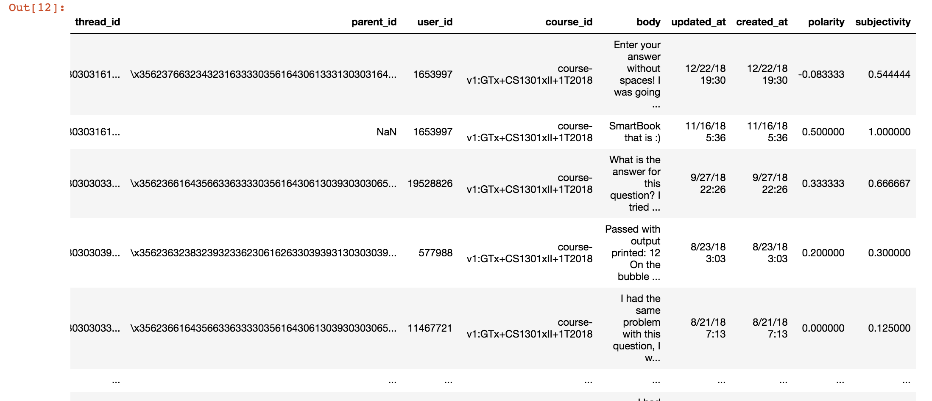
Polarity and Subjectivity
Used TextBlob in the Python library to generate polarity and subjectivity scores in each thread, and created columns containing these values in the csv for the edX data.

Slide 14
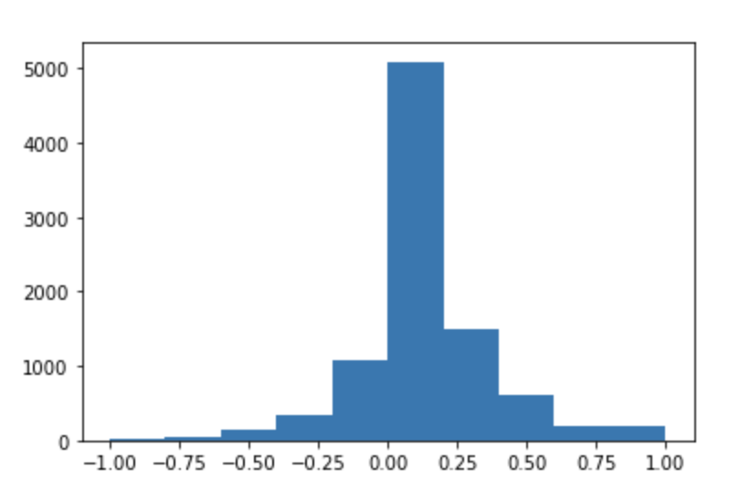
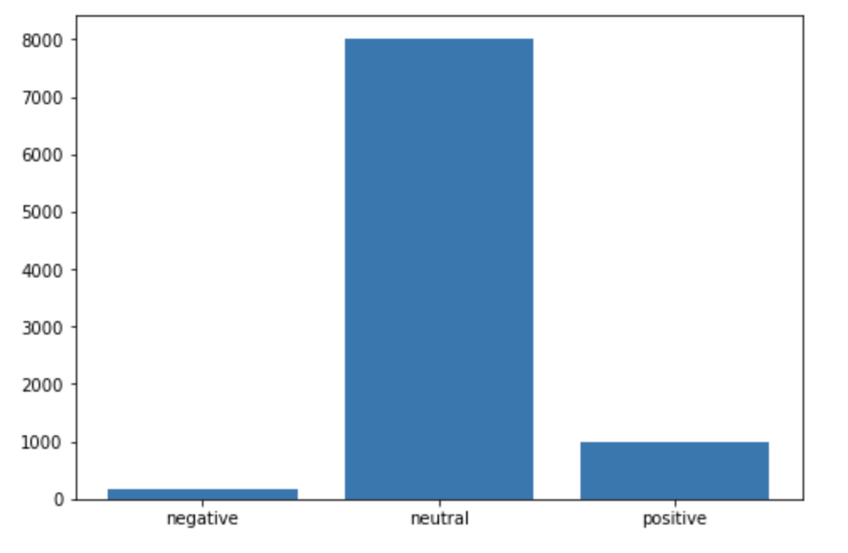
Polarity and Subjectivity- Next Steps
Currently, we are working with the web development team on finding the best way to visualize this data, and organize the data in a pipeline easier to be used by the web development team.
Regarding visualization, we created two types of histograms containing the frequencies of the polarity scores using matplotlib.
  These types of diagrams were used in a similar study looking at tweets about COVID-19 (Kabir)

Slide 15
Goals on Data Science
Done:
  Provide post density data
  Provide polarity and subjectivity values to front end team
  Feasibility analysis for cognitive presence
Current priorities:
  End-to-end model predicting cognitive presence value from test
  Aid in front end visualization
Backlog:
  Predict posts which will require TA or professor intervention
  Enhance keyword search
  Analyze student engagement
  Topic modeling of posts

Slide 16
Web Application Development Team
Researched stakeholder interest in web application content
Began work on creating a relational database for the edX data
  Data is currently in CSV (comma separated values) files
  SQLAlchemy is a library that allows communication between Python programs and databases
Settled on approach for dynamic routing within the application
Explored appropriate data visualizations

Slide 17
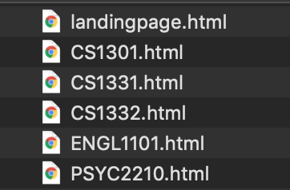
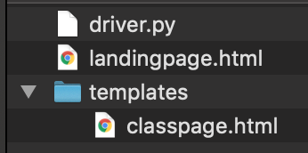
Dynamic Routing
static - having a separate file for each individual class
  leads to problems
dynamic - having a template file and filling it with a class’s information
  much more efficient
Dynamic file structure
Static file structure

Slide 18


Dynamic Routing
Tools:
  Flask
    Python
    “micro web framework”
    lightweight
  Jinja2
    template engine
    packaged with Flask
    allows for dynamic routing

Slide 19
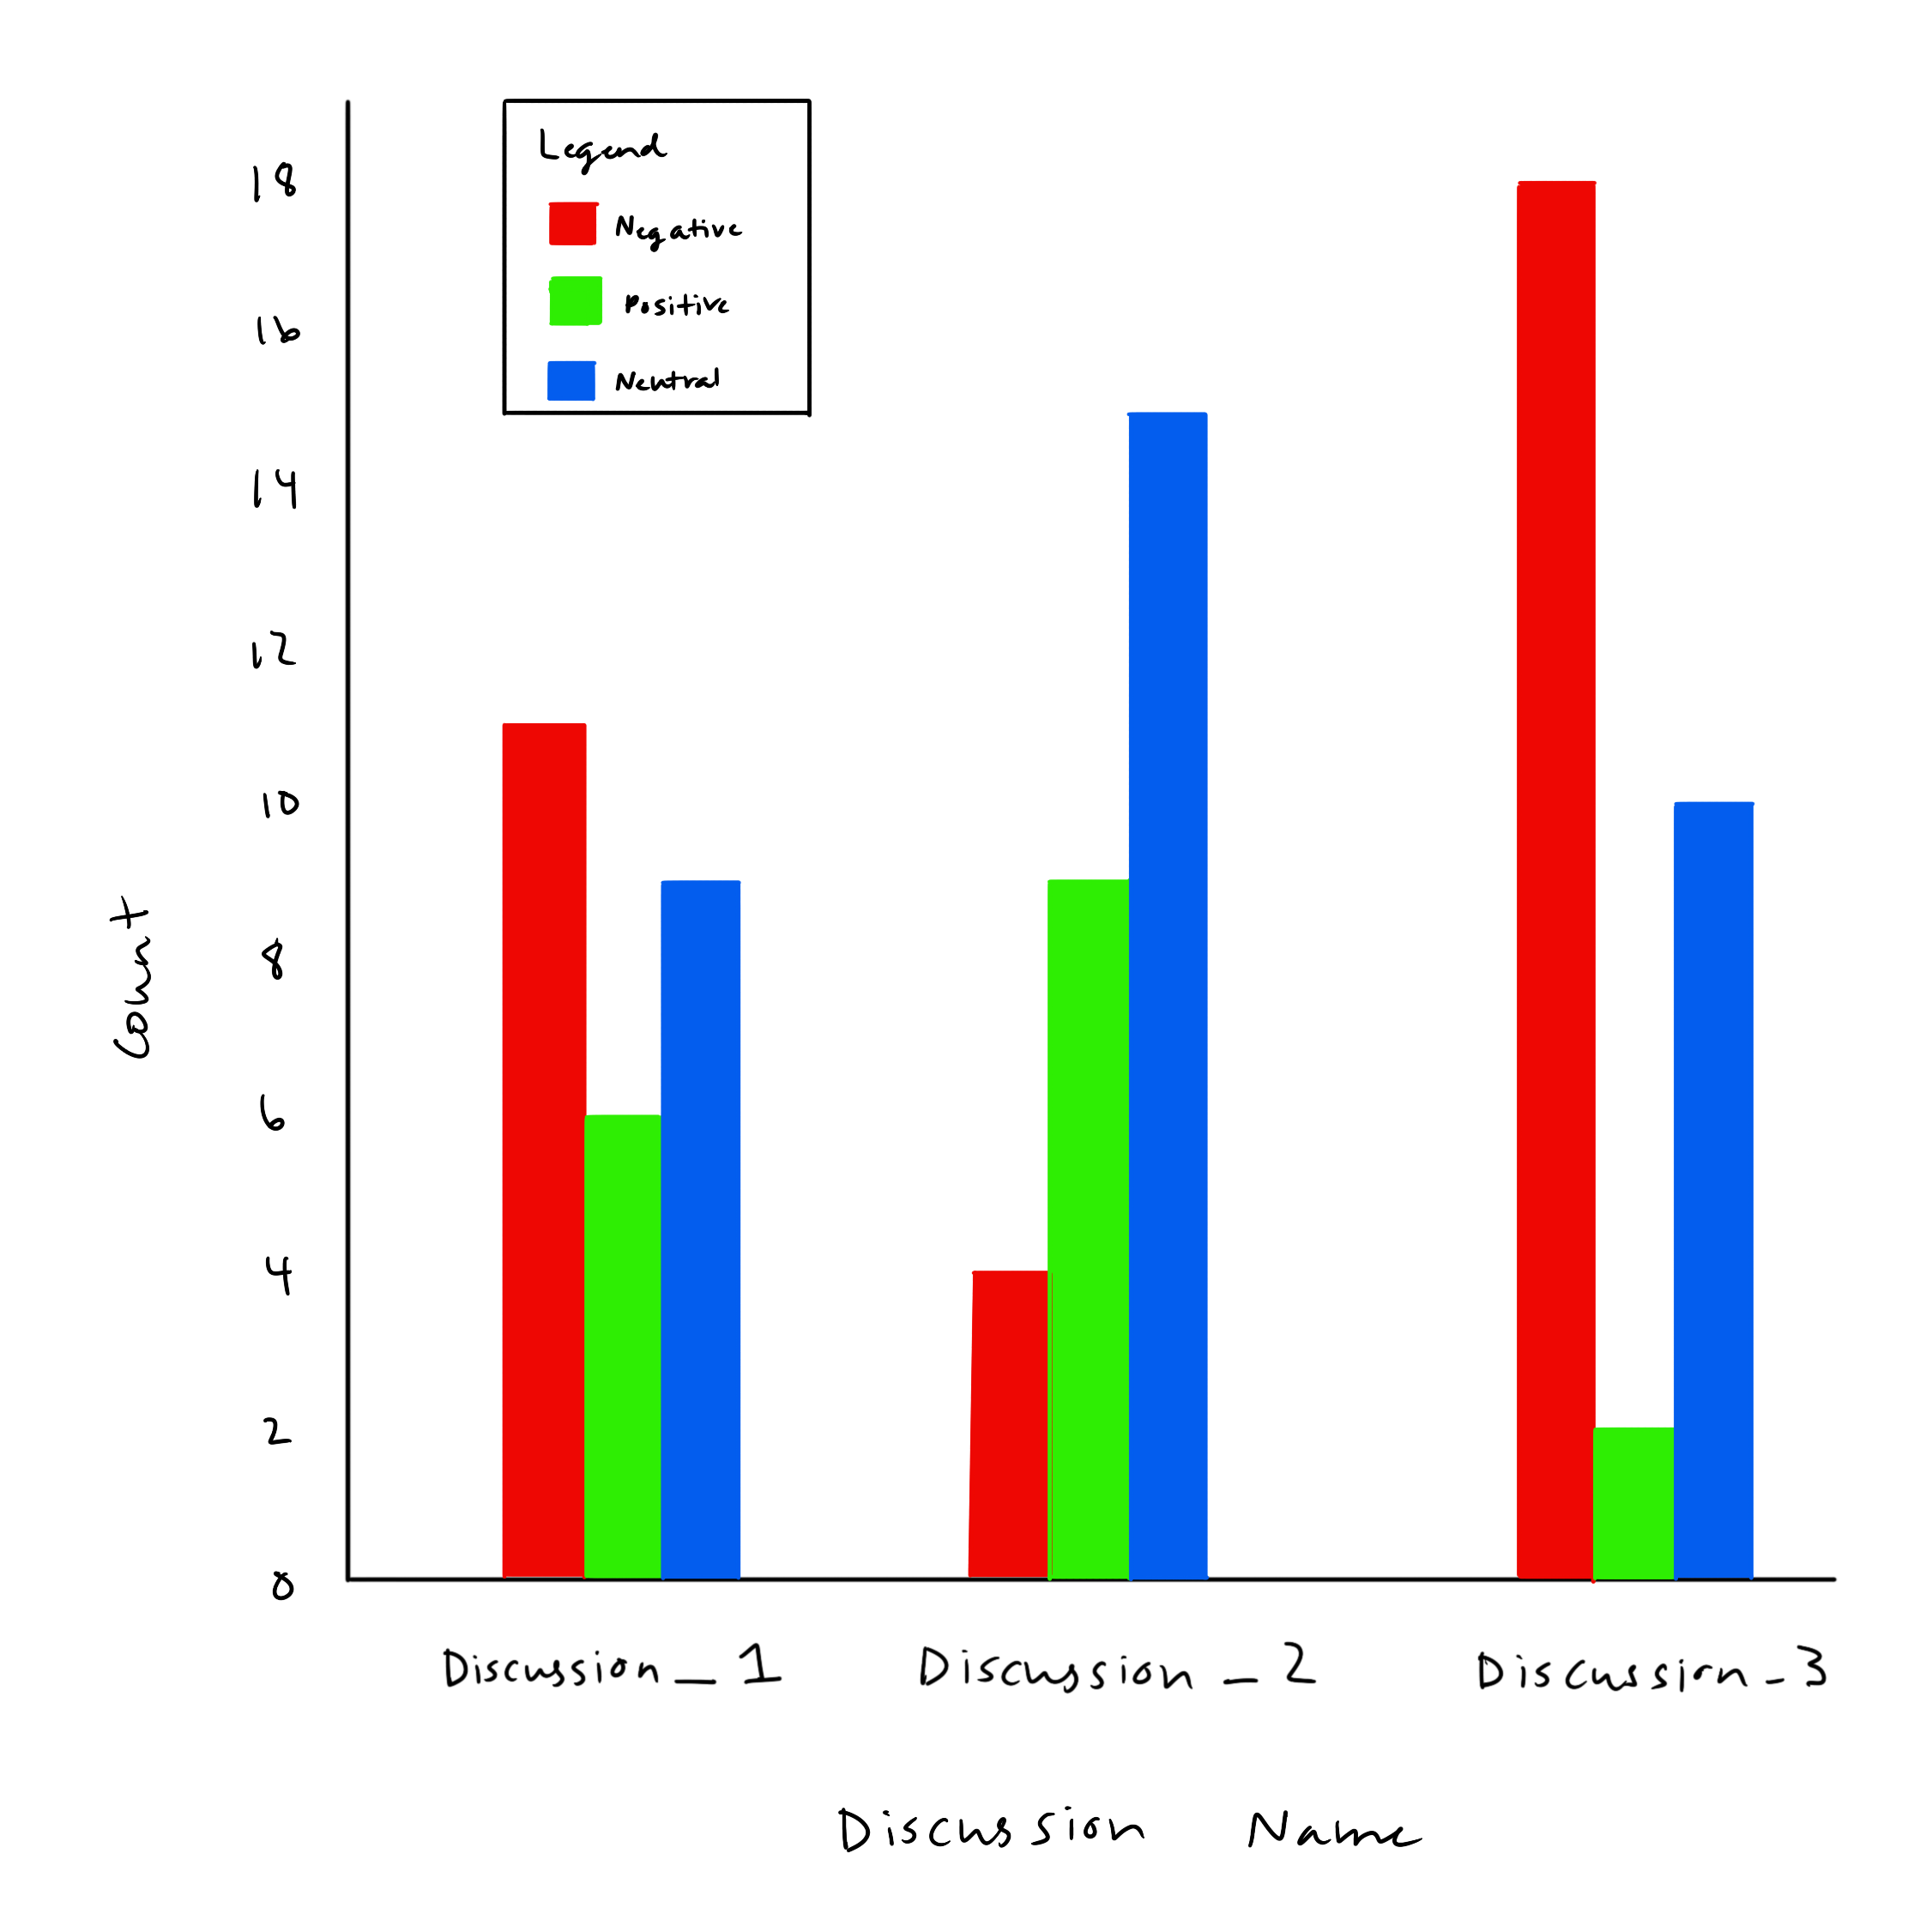
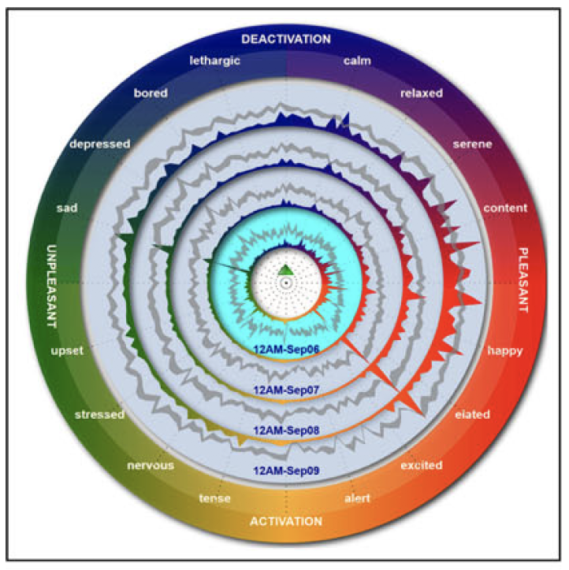
Data Visualizations - Polarity Score
More complex
(Kucher et al., 2018)
Basic

Slide 20
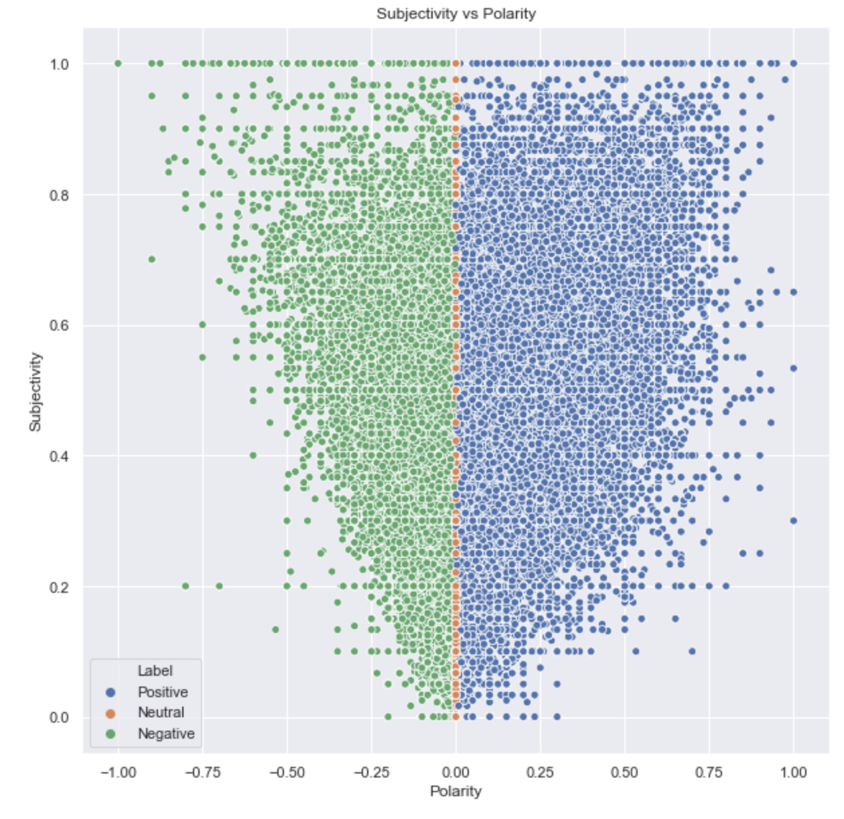
Data Visualizations - Subjectivity vs. Polarity
Goal: hover over each dot to get specific discussion information, click on it for more information
Uses TextBlob (Python library)
Source: towardsdatascience.com
Notes:
https://towardsdatascience.com/sentiment-analysis-on-the-tweets-about-distance-learning-with-textblob-cc73702b48bc

Slide 21
Data Visualizations - Engagement
Multiple metrics
  Amount of students in the class participating
  Amount of students in the class participating in one specific discussion forum
  How they are participating (asking a question, answering a question)
  Types of discussions they are participating in (question about content, syllabus question)
Next step: experiment with different data visualizations for multiple metrics

Slide 22
Goals on Web Development
Create table schema for edX data or leverage csvkit to import CSV files into PostgreSQL
Once the database is in place, begin implementing dynamic routing
Convert data visualizations to code with dummy data (and eventually real data)

Slide 23
Conclusion
The web development team will continue working on creating a modular app that will pull from an edX database to display useful metrics and visualizations
Work done by the data science team will be progressively integrated into the web application

Slide 24
Citations
https://csvkit.readthedocs.io/en/latest/
https://towardsdatascience.com/sentiment-analysis-on-the-tweets-about-distance-learning-with-textblob-cc73702b48bc
Kucher et al. (2018). The State of the Art in Sentiment Visualization. Computer Graphics Forum, 37(1), 71-96.
Kabir, Md Yasin, and Sanjay Madria. "CoronaVis: A Real-time COVID-19 Tweets Data Analyzer."
Kusner et al. (2015). From Word Embeddings To Document Distance. Proceedings of the 32nd International Conference on Machine Learning
Hu, Yuanyuan & Donald, Claire & Giacaman, Nasser & Zhu, Zexuan. (2020). Towards automated analysis of cognitive presence in MOOC discussions: a manual classification study. 135-140. 10.1145/3375462.3375473.
Kovanovic, Vitomir & Gasevic, Dragan & Hatala, Marek & Siemens, George. (2017). A Novel Model of Cognitive Presence Assessment Using Automated Learning Analytics Methods. 10.13140/RG.2.2.10611.32804.
D. Randy Garrison, Terry Anderson & Walter Archer (2001) Critical thinking, cognitive presence, and computer conferencing in distance education, American Journal of Distance Education, 15:1, 7-23, DOI: 10.1080/08923640109527071

Slide 25
Questions?

